Slide 1
Capstone Project
ML
Bandlamudi Tanmayi

Slide 2
Problem Statement
Given a Data set consisting of hotel bookings and status i.e. wether the booking is cancelled or not. Basis on the data a binary classification model is to be created with maximum accuracy possible.
Data Set Contains columns:
‘hotel', 'is_canceled', 'lead_time', 'arrival_date_year', 'arrival_date_month', 'arrival_date_week_number', 'arrival_date_day_of_month', 'stays_in_weekend_nights', 'stays_in_week_nights', 'adults', 'children', 'babies', 'meal', 'country', 'market_segment', 'distribution_channel', 'is_repeated_guest', 'previous_cancellations', 'previous_bookings_not_canceled', 'reserved_room_type', 'assigned_room_type', 'booking_changes', 'deposit_type', 'agent', 'company', 'days_in_waiting_list', 'customer_type', 'adr', 'required_car_parking_spaces', 'total_of_special_requests', 'reservation_status', 'reservation_status_date'

Slide 3
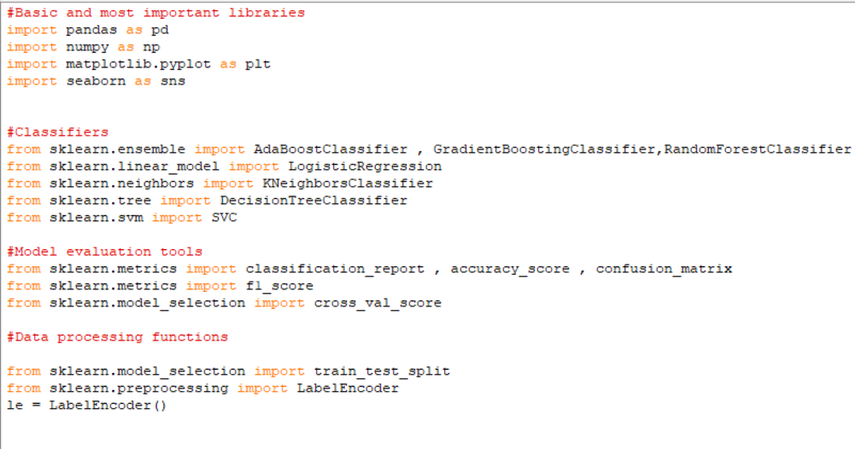
Importing Libraries:

Slide 4
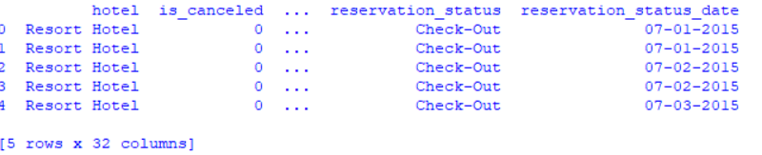

Load the Dataset:

Slide 5
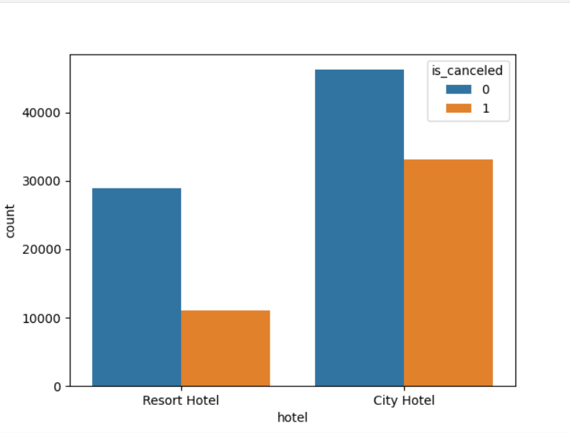
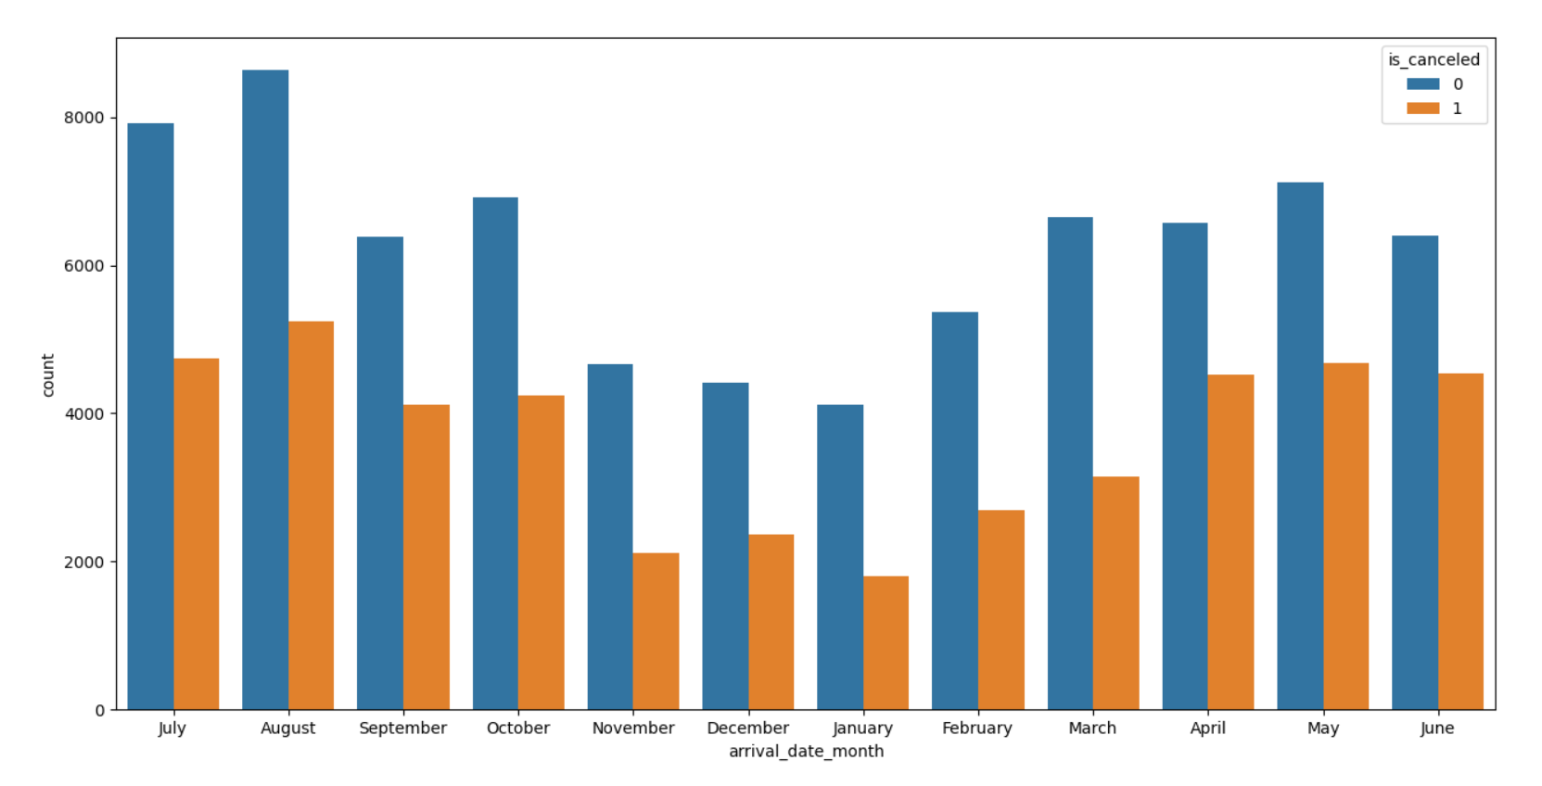
Visualization:

Slide 6
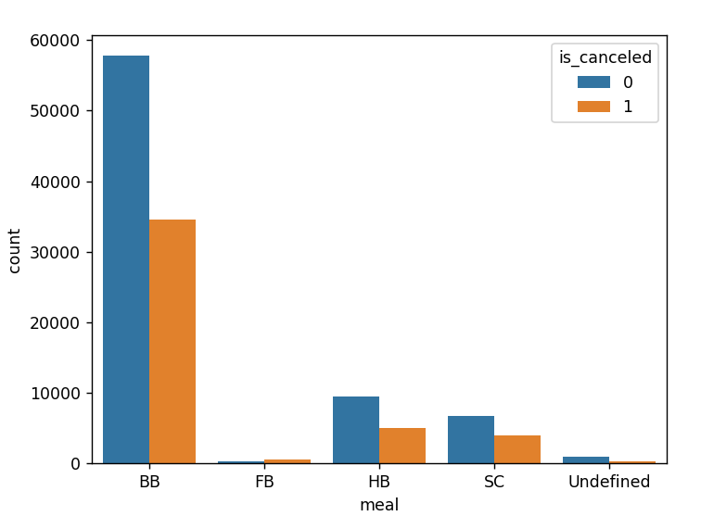
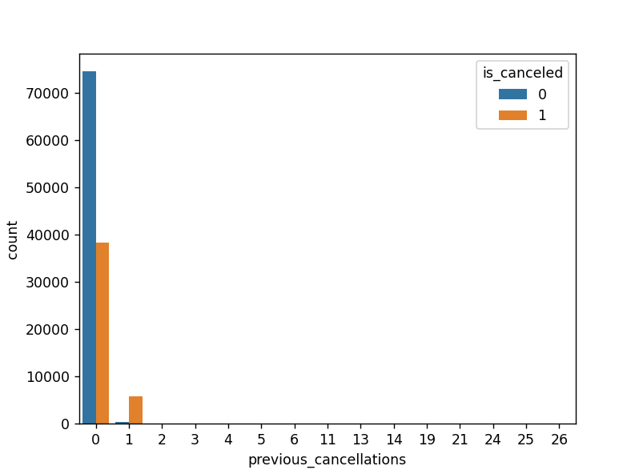

Slide 7

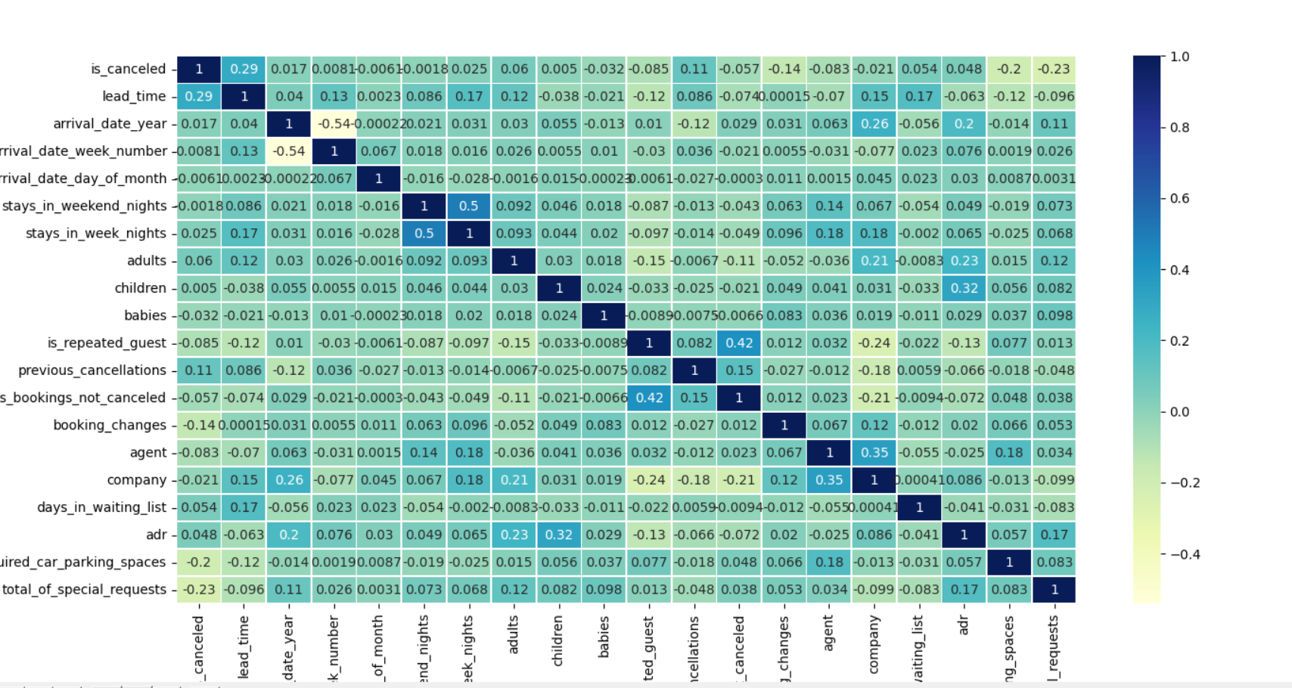
Correlation Matrix:

Slide 8

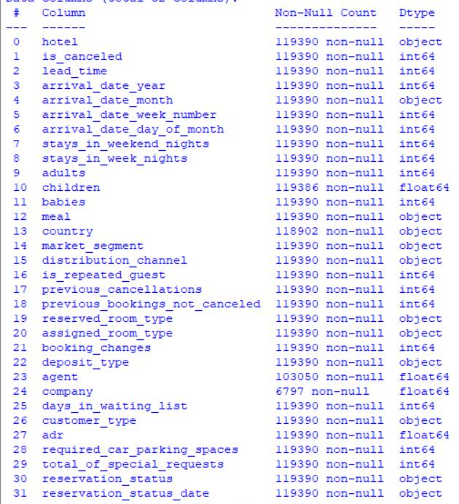
Knowing data types of the columns:

Slide 9

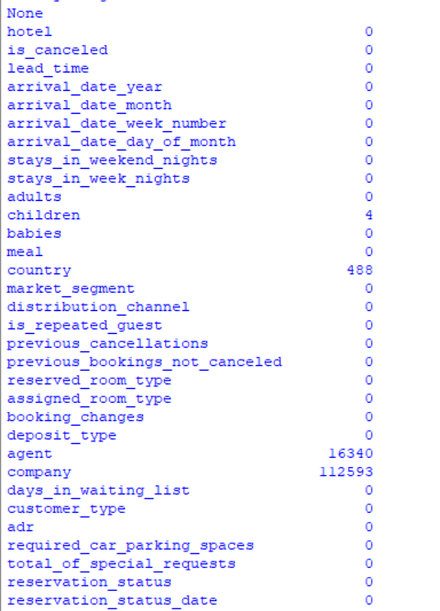
Finding Null Values:

Slide 10

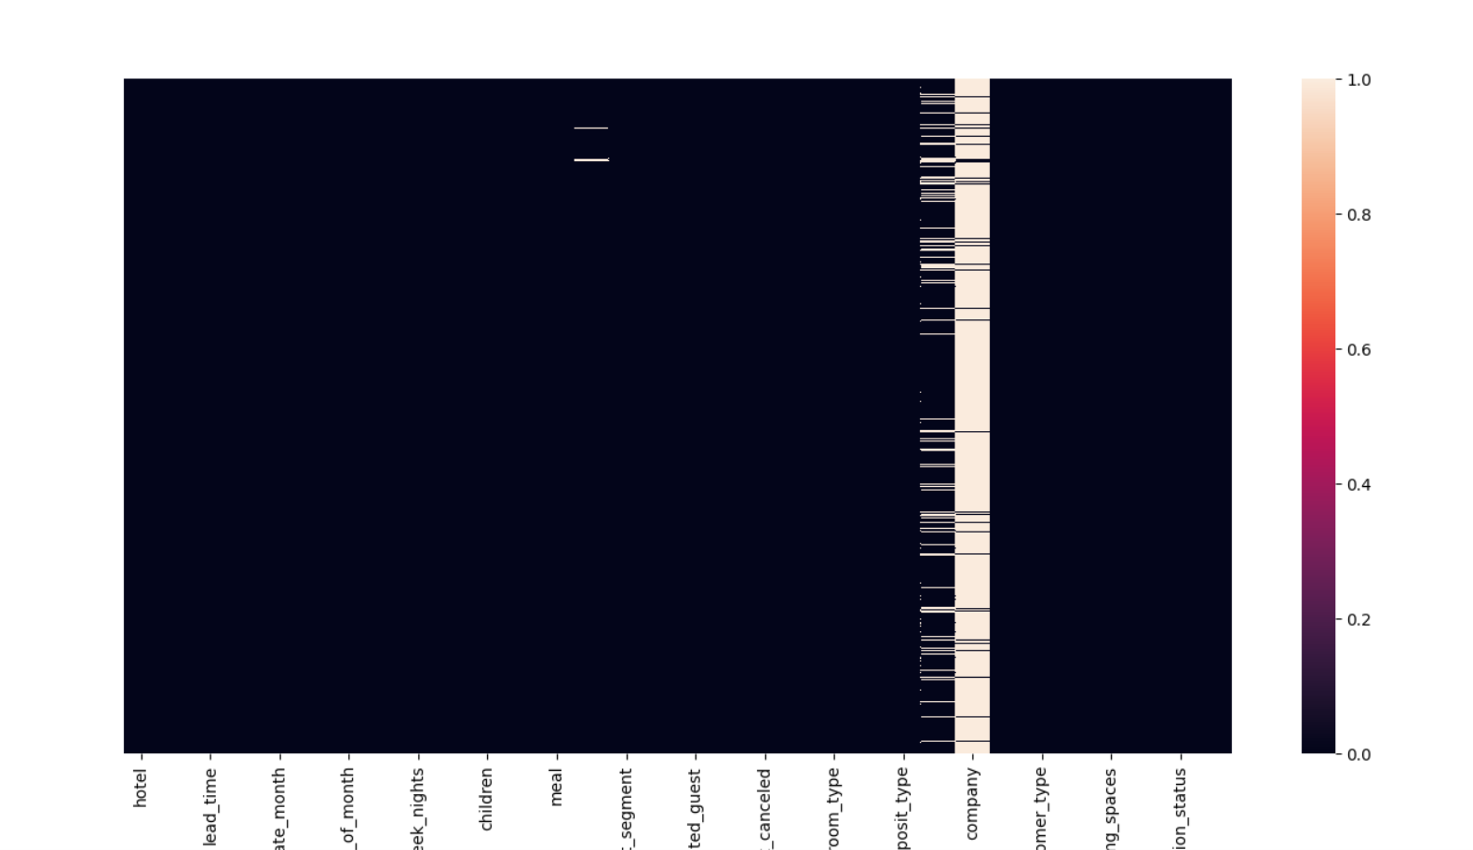
Visualizing Null Values:

Slide 11

Replacing Null Values:
Here Null values of
Numerical or int float data type values are replaced with median
And categorical or object data type values are replaced with mode

Slide 12
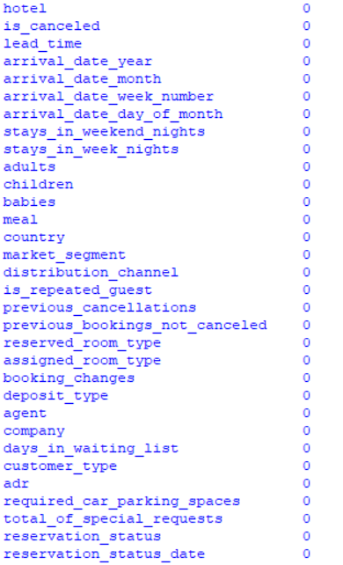
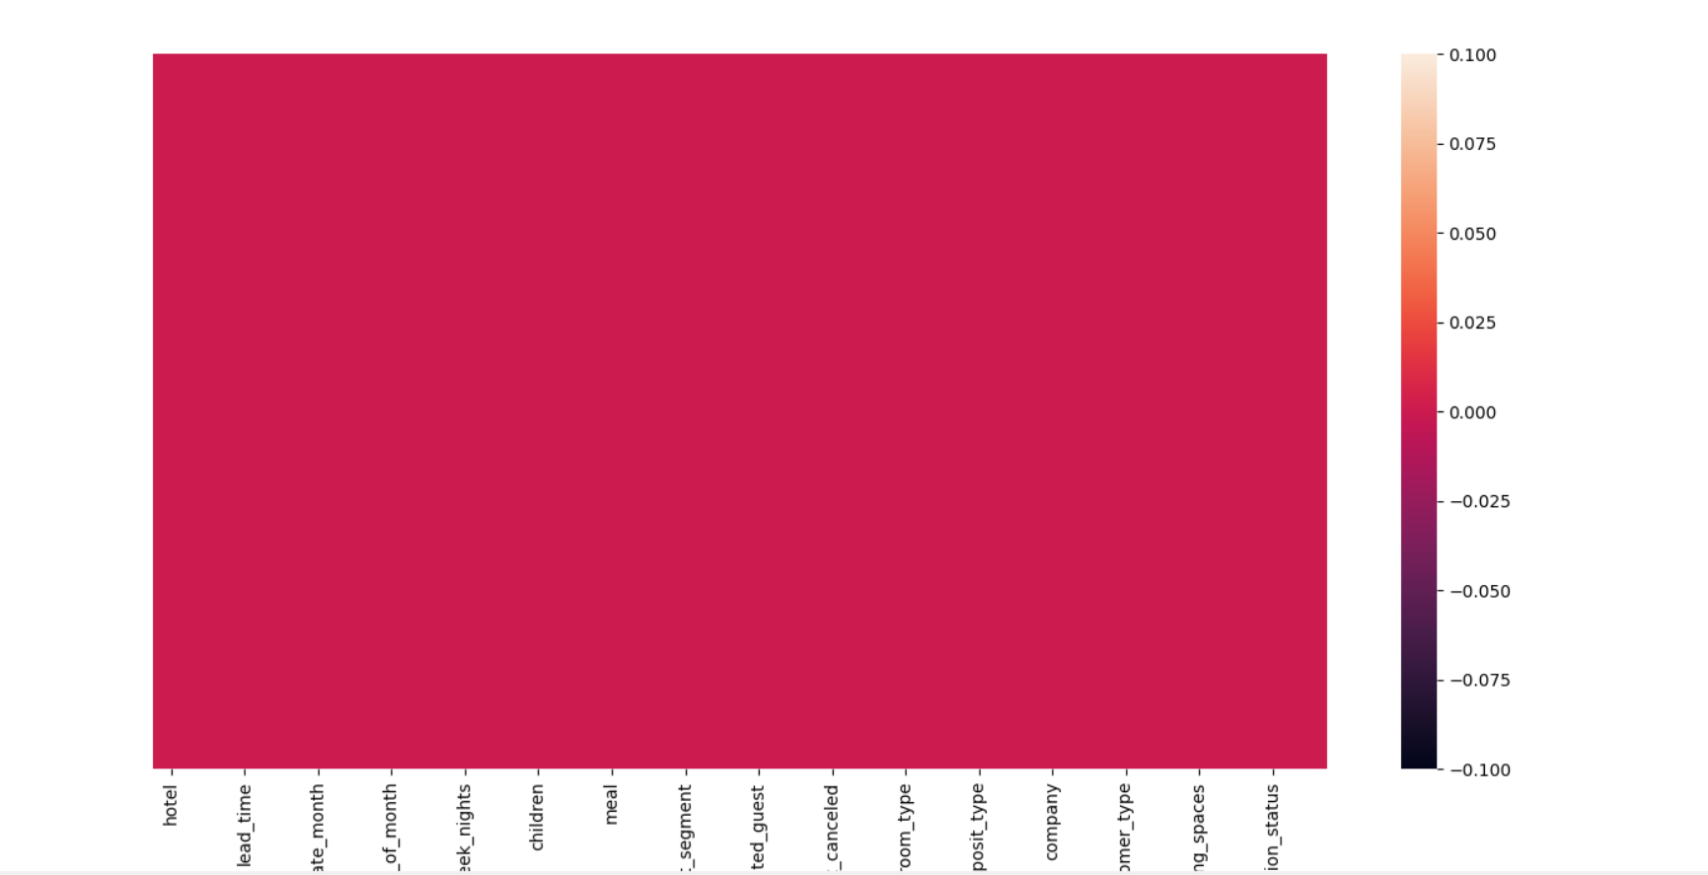
Verification of Null Values:

Slide 13


Checking and Dropping Duplicate Values:

Slide 14
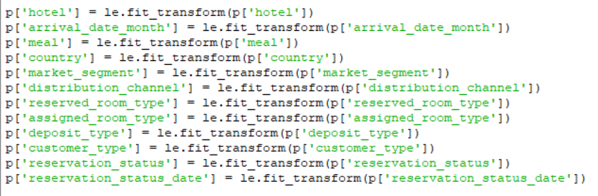
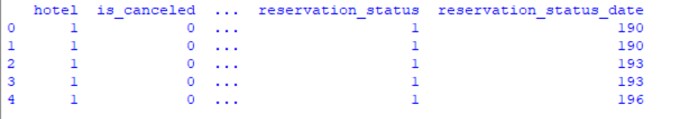
Encoding:
In this encoding all the categorical data are converted into numerical data.

Slide 15

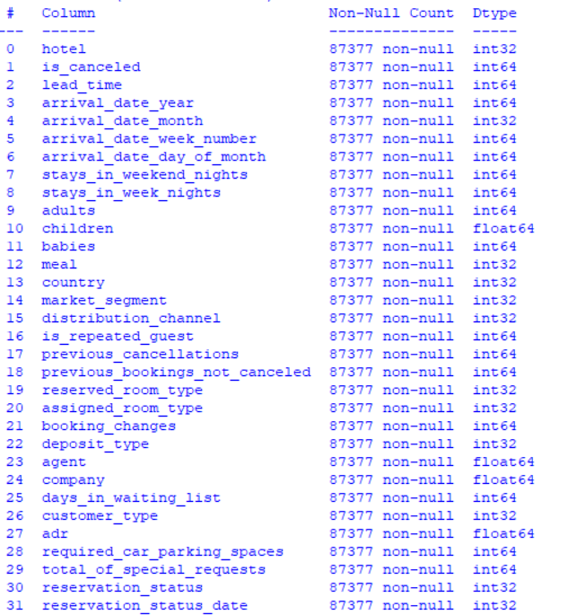

Slide 16

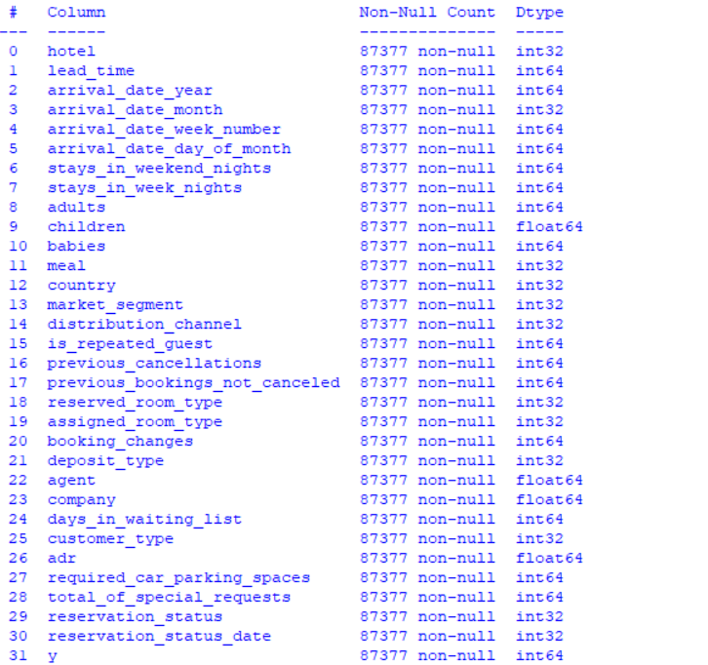

Slide 17

Dividing data into Input X variables and Target y variable:
Splitting the data into Training and Testing Data:
So we need to do the classification based on different algorithms and choose the best algorithm basis on the criteria of accuracy score.
Algorithms used:
Logistic Regression
Decision Tree
KNN
Naïve Bayes
Boosting

Slide 18
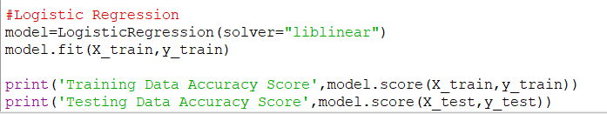

Logistic Regression:
Accuracy Score:

Slide 19
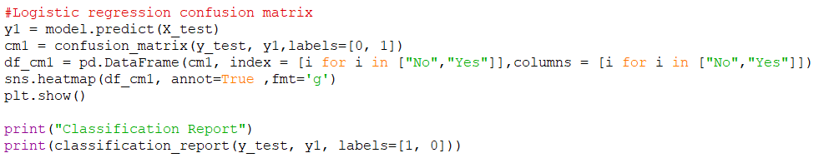
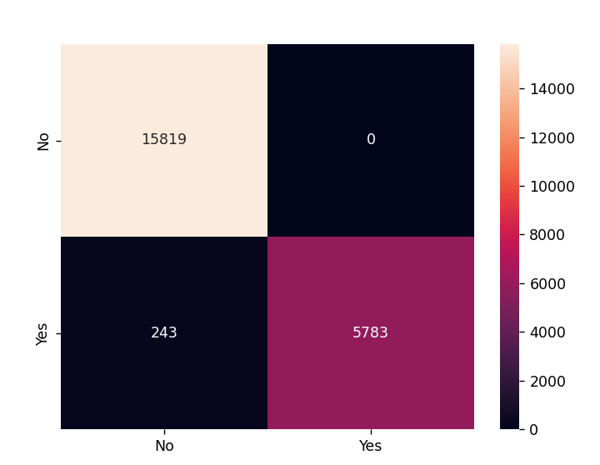
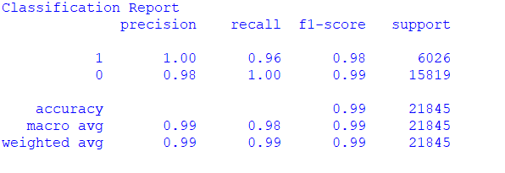
Confusion Matrix:

Slide 20
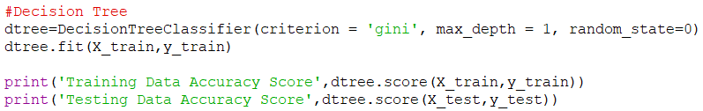
Decision tree:
Accuracy Score:

Slide 21
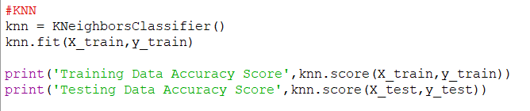
KNN:
Accuracy Score:

Slide 22
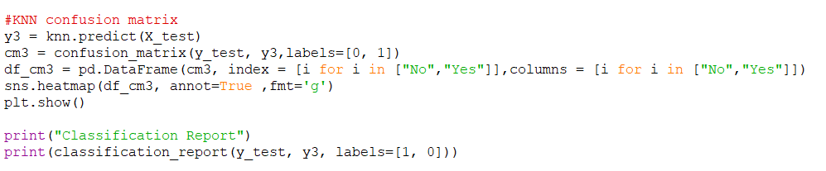
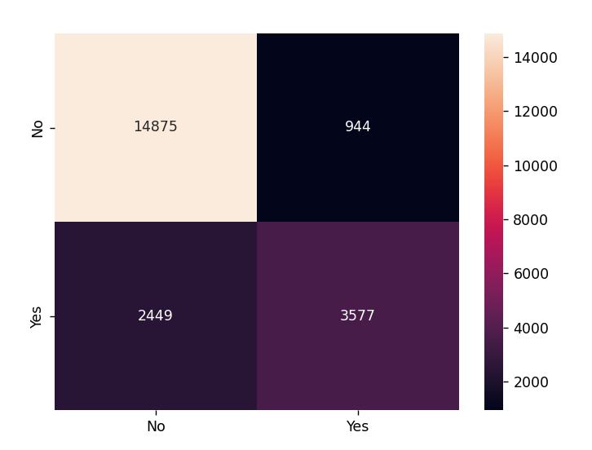
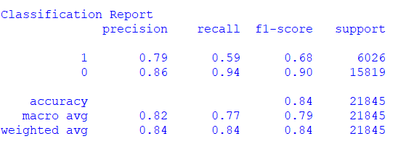
Confusion Matrix:

Slide 23
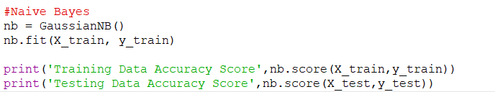
Naïve Bayes:
Accuracy Score:

Slide 24
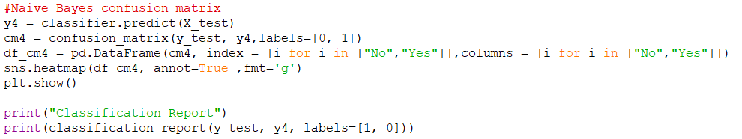
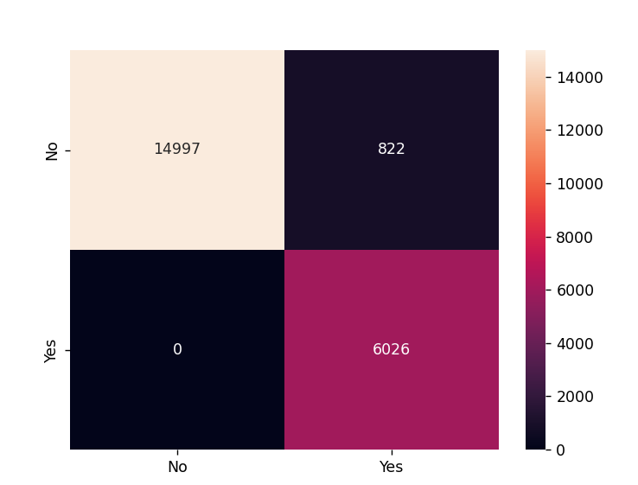
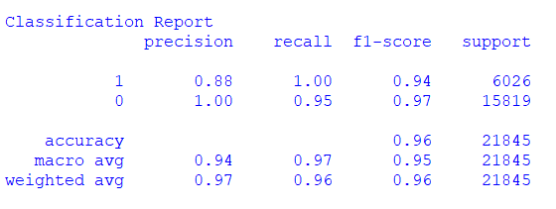
Confusion Matrix:

Slide 25
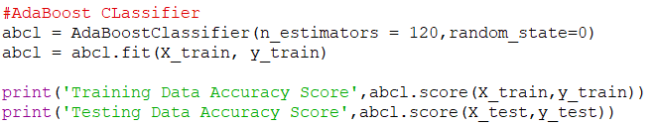

AdaBoost Classifier:
Accuracy Score:

Slide 26
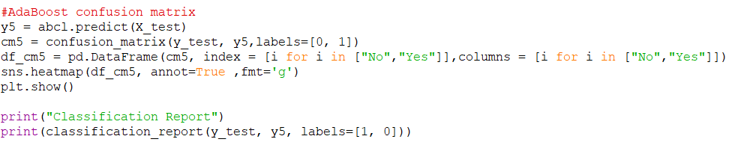
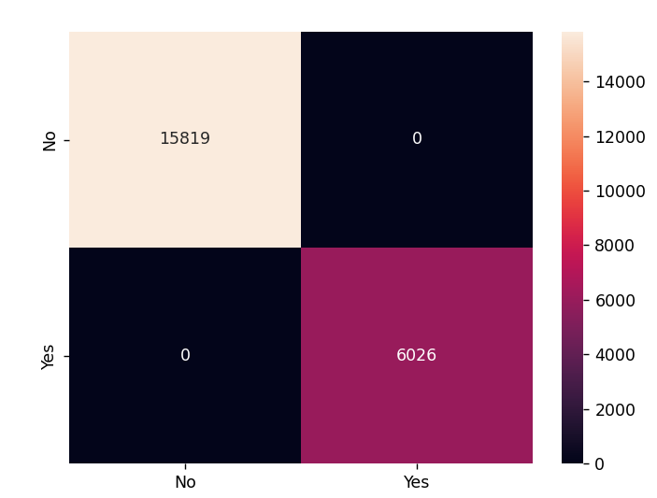
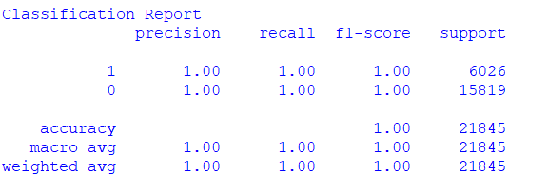
Confusion Matrix:

Slide 27
Conclusion:
Algorithm Chosen ---------> Accuracy
The model with highest accuracy is chosen
Here we have the highest accuracy for AdaBoost Classifier
Highest Accuracy is 1.00 i.e. 100%

